Slide 1



Lay eucharistic ministry
Welcome!
training

Slide 2
introduction
<Photo>
<Presenter name>
Notes:
Add your photo and name to the slide.

Slide 3
agenda
objectives
A little theology
Sharing Communion in church
Sharing Communion in homes
Let’s have a go!

Slide 4

A little theology
Background of the eucharist and its meaning
1 Corinthians 11:17-end

Slide 5
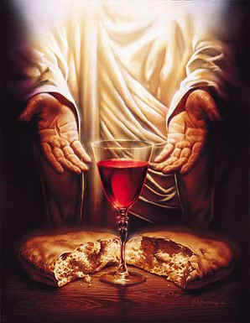
A little theology
Synoptic gospels
“Take, eat, this is my body”
“This is my blood”
Literal or figurative?

Slide 6
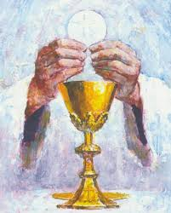
A little theology
John’s gospel
John 6: 22-59

Slide 7
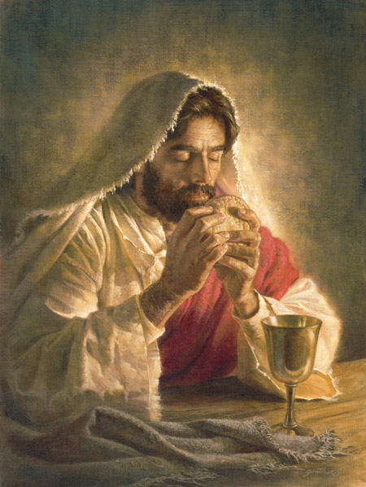
A little theology
John’s gospel
“Those who eat my flesh and drink my blood have eternal life…” (John 6: 55)

Slide 8
A little theology
Old testament reflections
Sabbath Meal
Passover Meal
Messianic Meal

Slide 9
A little theology
EUCHARISTIC THEOLOGIES
Transubstantiation
Consubstantiation
Memorialist
Receptionist

Slide 10

A little theology
Discussion time
What does Holy Communion
mean to you?

Slide 11

Sharing communion
In the church

Slide 12
Administering
In the church
What is your experience?

Slide 13
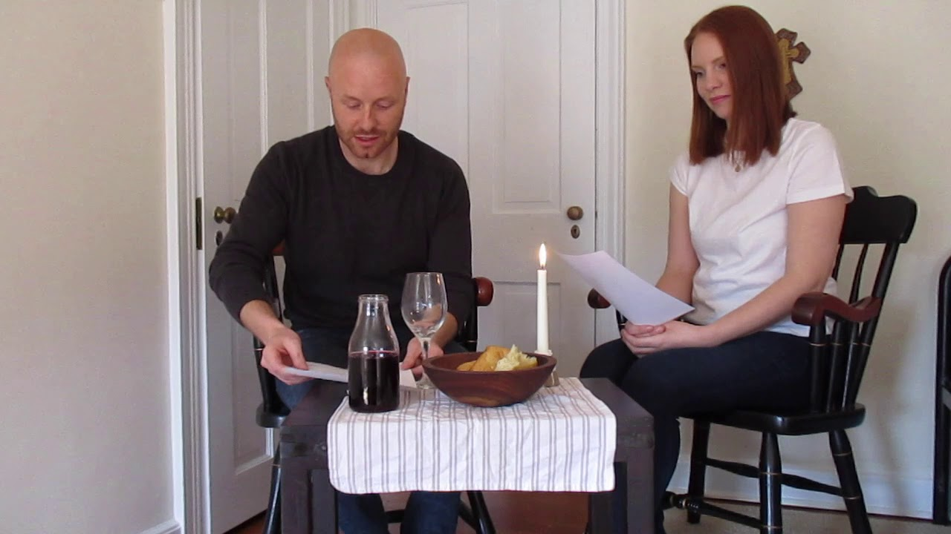
Administering
In home

Slide 14
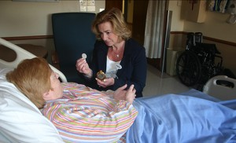
Administering
In hospital

Slide 15
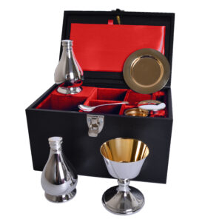
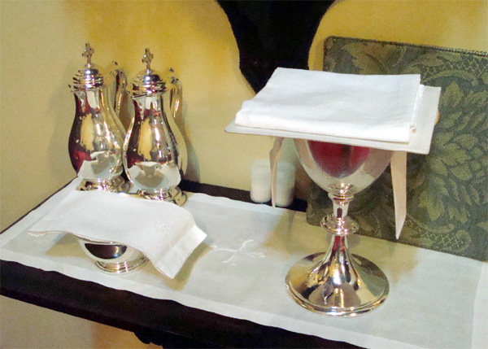
Have a go!

Slide 16

pray

Slide 17
Lay eucharistic ministry
training

